Slide 1





Predictive Analytics Pt. I
Lab 5

Slide 2
Agenda
Models and prediction
Concepts in machine learning
Random forests, training & predicting
Notes:
Some people’s opinion is that if you’re predicting, it’s a machine learning approach

Slide 3
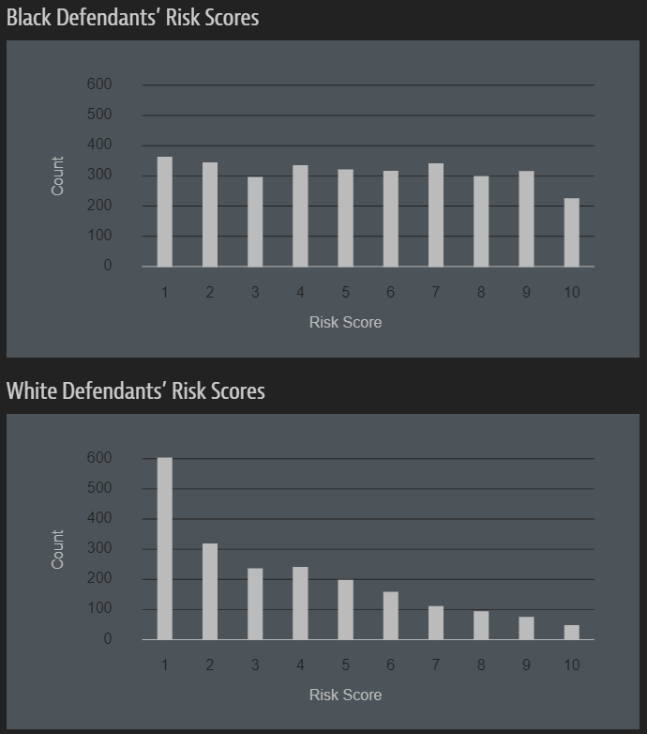
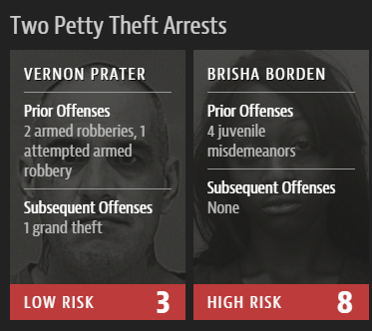

The COMPAS risk assessment tool (model)
137-item questionnaire
“Have you ever been a gang member?”
“Were you using drugs or under the influence when arrested?”
“What was your final grade completed in school?”
New York, Wisconsin, California, Florida
Notes:
Started in 1989, rolled out in NYS in 2010. In 2014, US Attorney General Eric Holder requested an investigation into whether these risk scores were injecting bias into the justice system – never got an answer. ProPublica investigation conducted in 2016

Slide 4
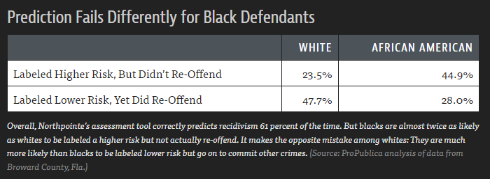
2016 – ProPublica investigation and analysis
Risk scores predicted by COMPAS model, ProPublica analyzed predictions from risk scores
Calculation of risk scores not disclosed
Correct predictions of recidivism (re-offense) 61% of the time
Dataset is publicly available
Analysis notebook with R/Python code
Much more to the story
Notes:
Started in 1989, rolled out in NYS in 2010. In 2014, US Attorney General Eric Holder requested an investigation into whether these risk scores were injecting bias into the justice system – never got an answer. ProPublica investigation conducted in 2016

Slide 5
Further reading
Predictive policing in Chicago
Racial bias in health care decision-making
Bias in predicting child abuse risk

Slide 6


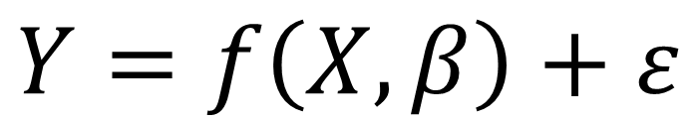
What is a model?
“An informative representation of an object, person or system” - Wikipedia
$$Y=f\left(X,β\right)+ε$$
All models require assumptions and decisions

Slide 7
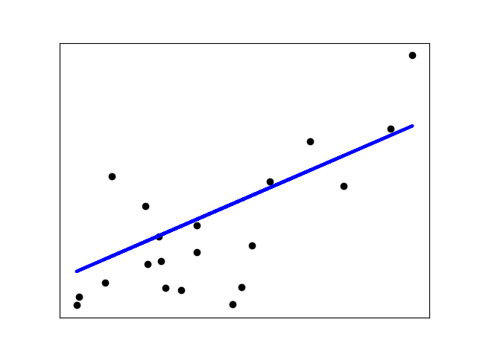

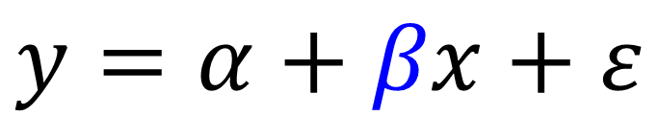
Explanation versus(?) prediction
$$y=α+βx+ε$$
Y
$$y_{new}=α+βx_{new}$$
X
Notes:
Explaining a causal mechanism ALWAYS makes a prediction

Slide 8
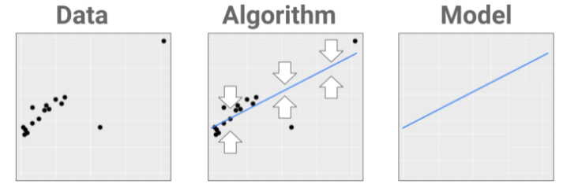
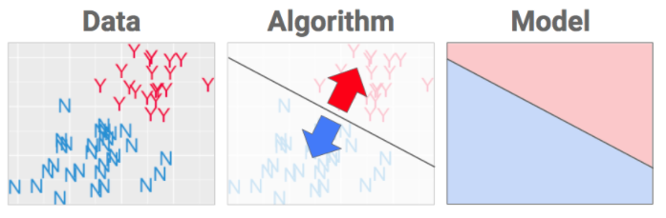
Types of prediction tasks
Fitting the data (regression)
What is this person’s risk score?
Separating the data (classification)
What is this person’s risk category?

Slide 9
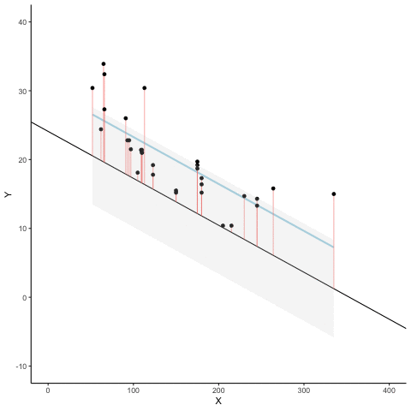
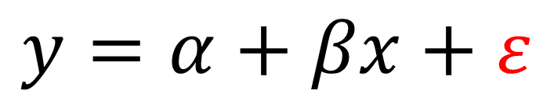
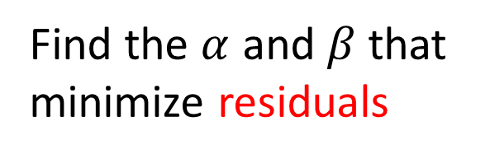
Linear regression
Algorithm:
Find the $α$ and $β$ that minimize residuals
Model:
$$y=α+βx+ε$$

Slide 10
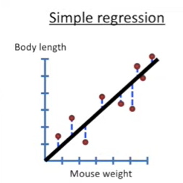
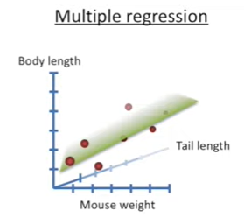
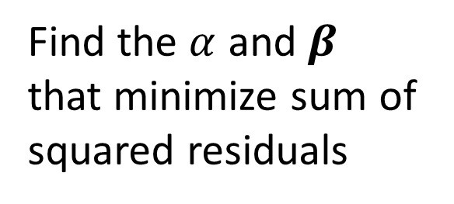
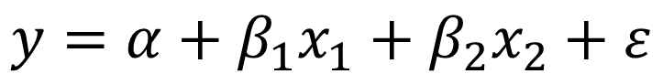
Multiple linear regression
Algorithm:
Find the $α$ and $β$ that minimize sum of squared residuals
Model:
$$y=α+β_{1}x_{1}+β_{2}x_{2}+ε$$
Mouse weight
Tail length

Slide 11
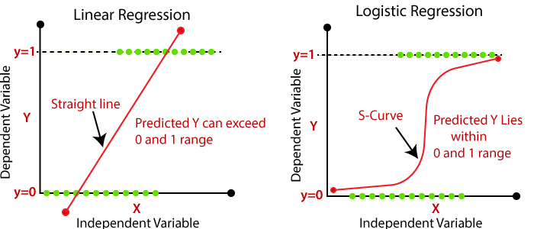
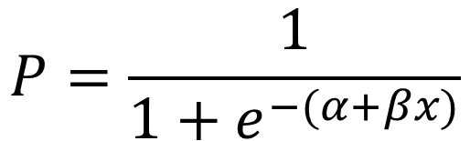
Logistic regression
Algorithm:
Find the curve that maximizes the likelihood of observing the data
Model:
$$P=\frac{1}{1+e^{−(α+βx)}}$$

Slide 12

What’s the best fit?

Slide 13
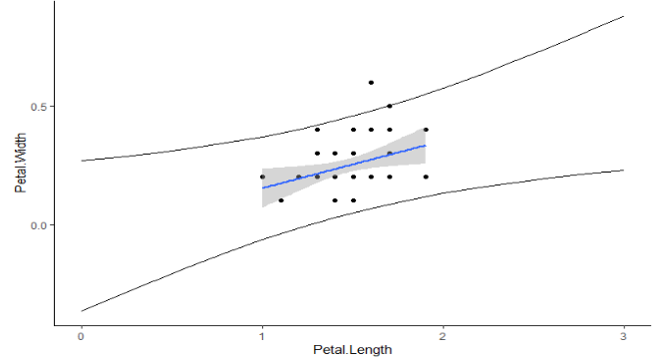

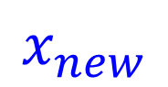
Prediction – interpolation & extrapolation
95% Prediction
Interval
$$x_{new}$$
$$x_{new}$$

Slide 14
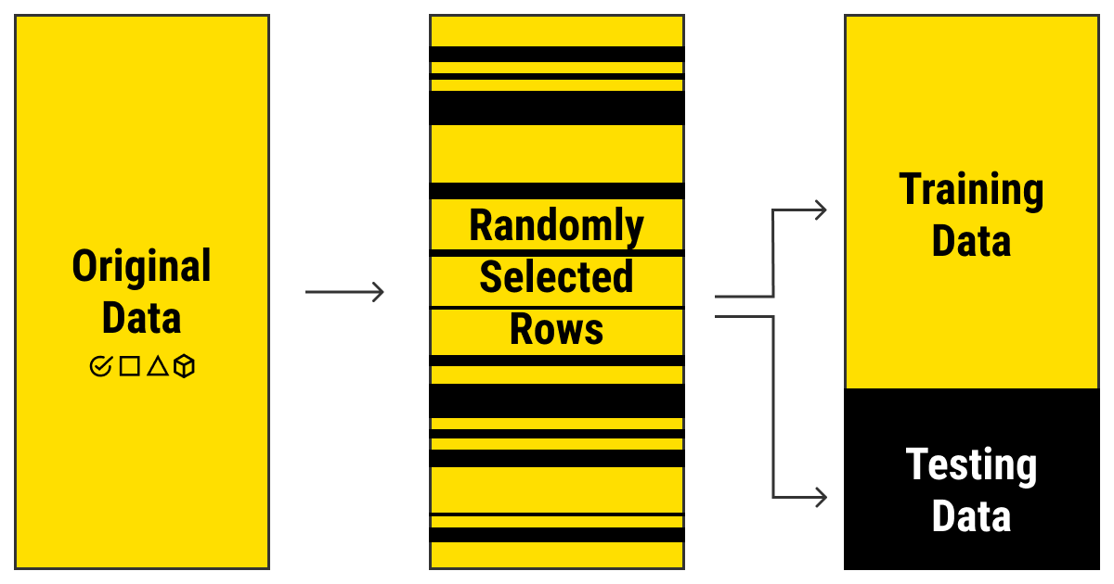
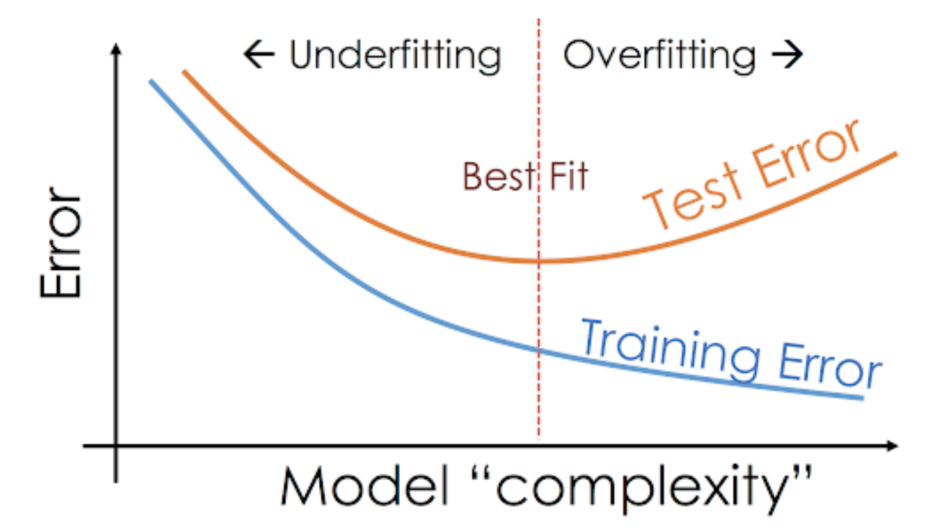
Training, testing, and overfitting
“bias-variance tradeoff” (related)

Slide 15
Machine learning
“Computer algorithms that can improve automatically through experience and by the use of data”
Pros: Outstanding tools for prediction (better than humans)
Cons: Difficult to understand for explanation

Slide 16
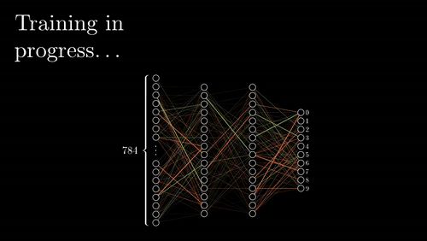
Machine learning

Slide 17
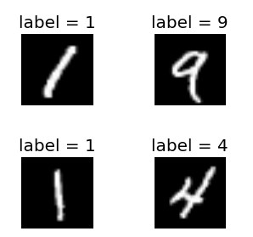
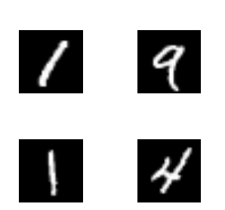
Many kinds of machine learning algorithms
Supervised
Ground truth available
Unsupervised
Ground truth unavailable

Slide 18

Random forests
Recommended Reading by
Breiman and Cutler
Easy to learn
Easy to execute
Easy to interpret
Difficult to overfit
Supervised: need ground truth data

Slide 19
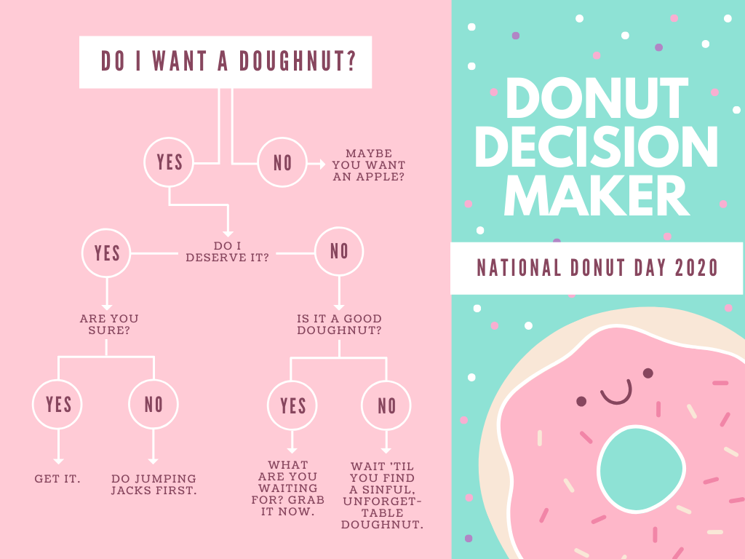

Slide 20
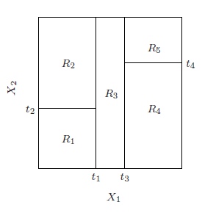
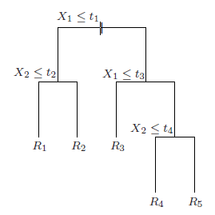
Growing a decision tree – classification task

Slide 21
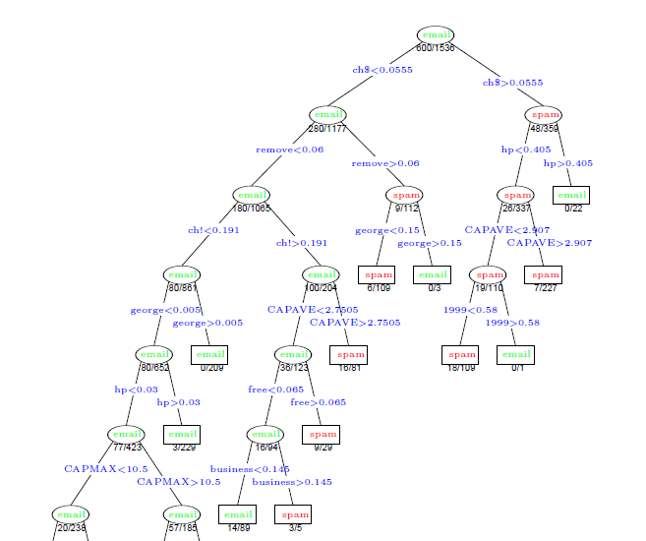
Email classifier

Slide 22
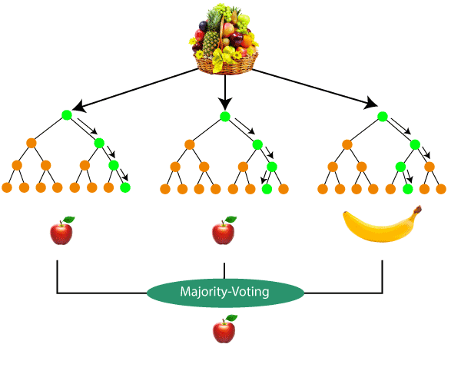

Slide 23

Random sample of training data
with replacement
“bagging”
De-correlates trees
OOB

Slide 24
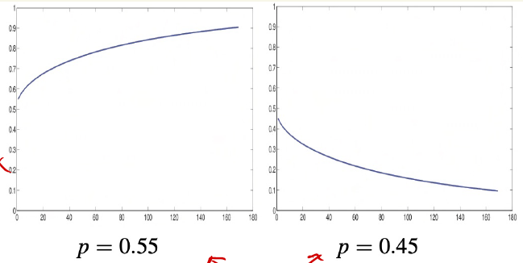
Wisdom of crowds – ensemble methods; “weak learners” Condorcet’s jury theorem
probability the majority
is correct
# of individuals
probability an individual is correct
Notes:
key assumption is that voters are independent

Slide 25
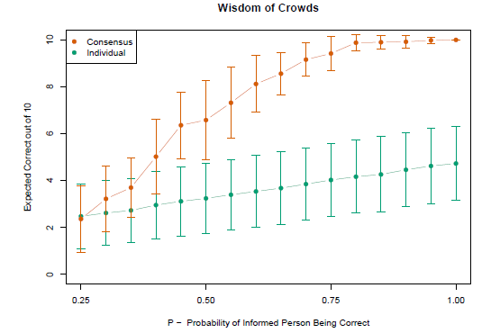
Ensemble methods – “weak learners”

Slide 26
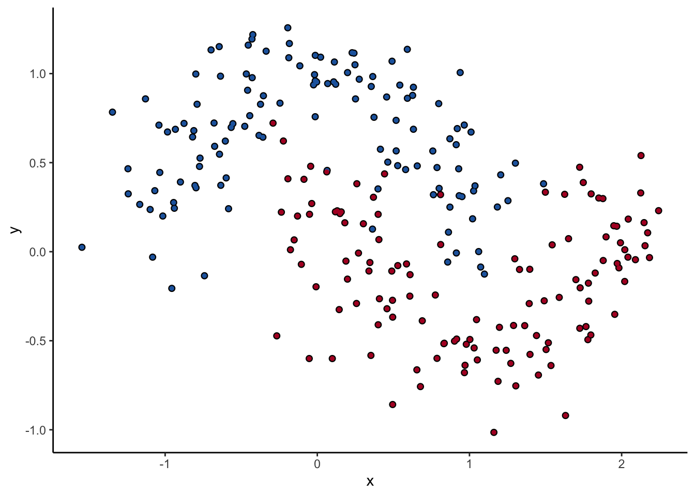
Ensemble methods – “weak learners”

Slide 27
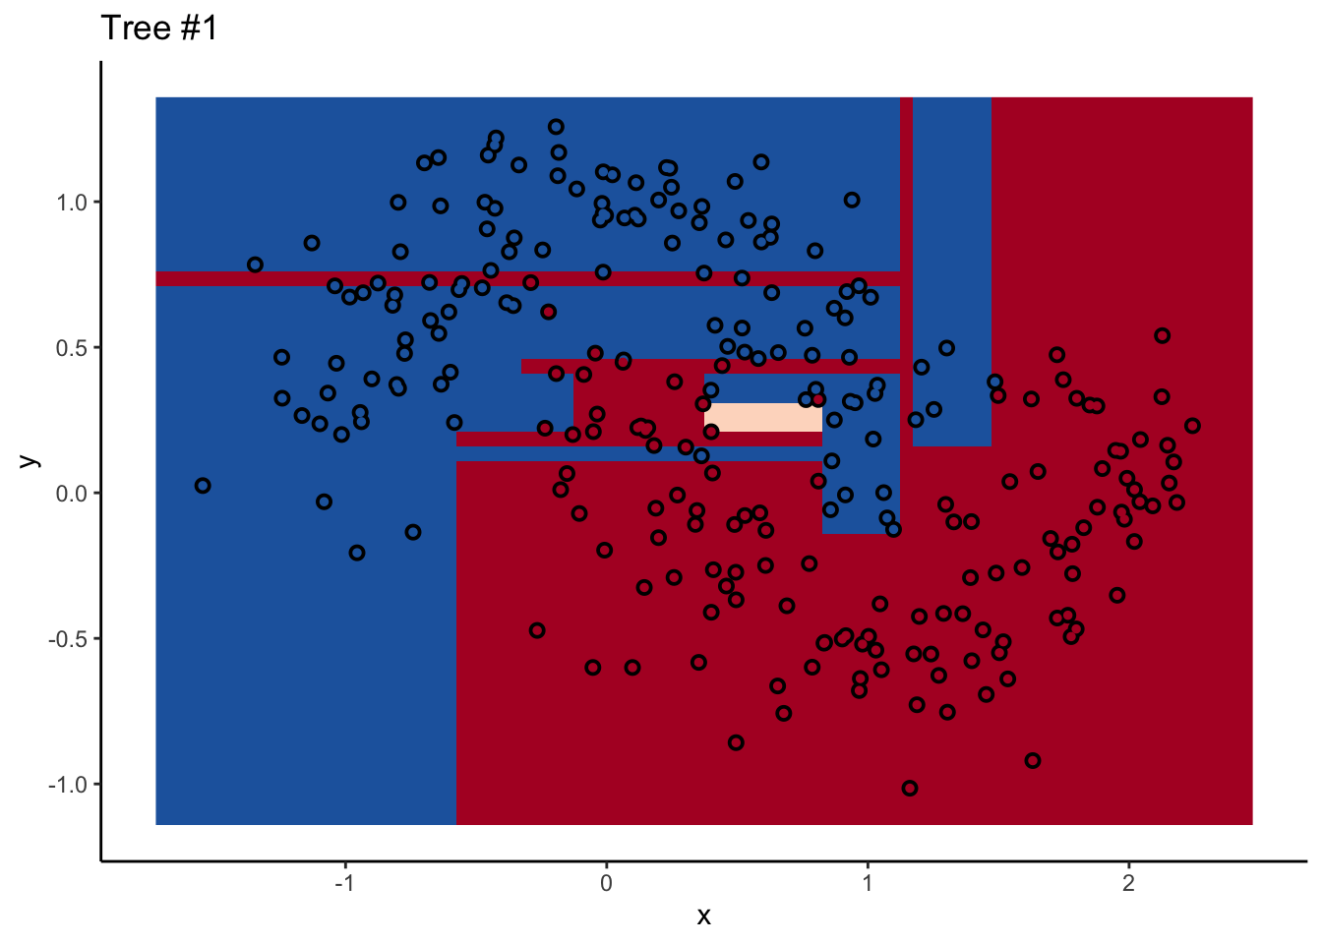
Ensemble methods – “weak learners”

Slide 28

Ensemble methods – “weak learners”

